Slide 2


Slide 3
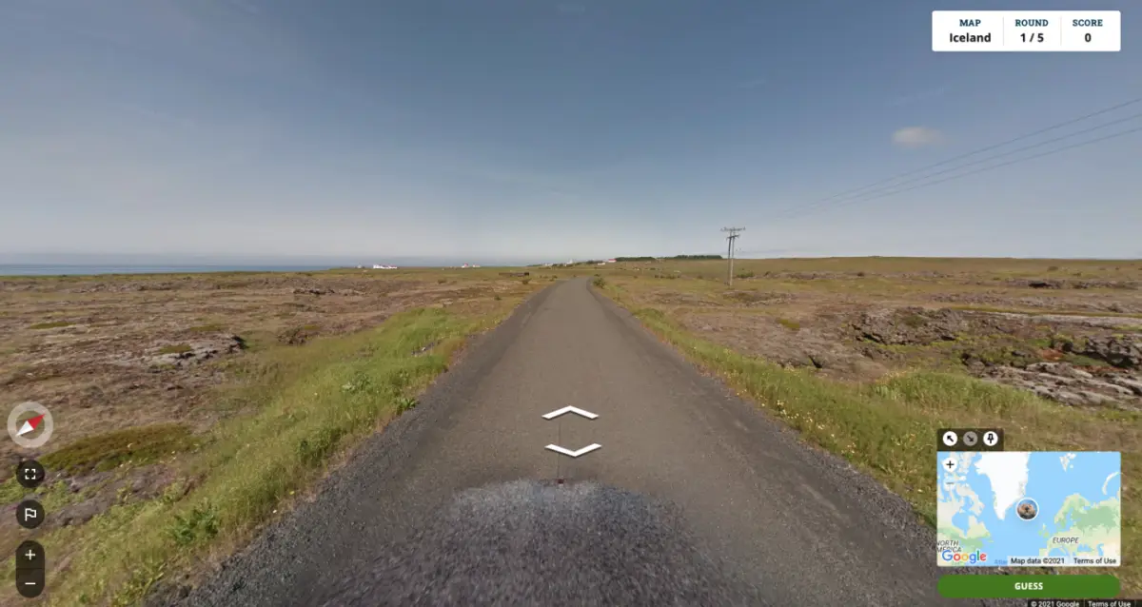

Slide 4
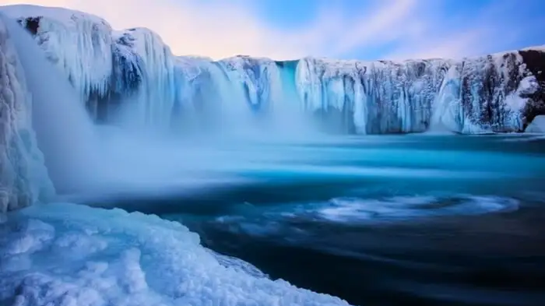
Iceland

Slide 5
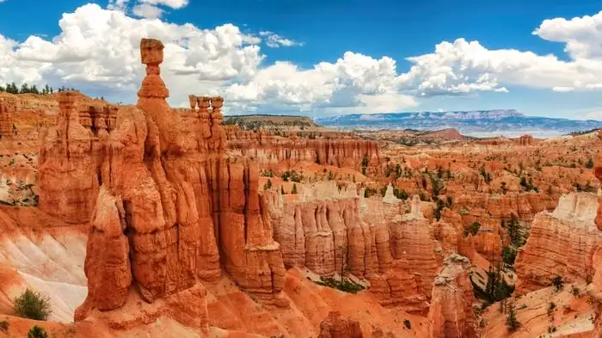
USA

Slide 6

France

Slide 7

Japan

Slide 8
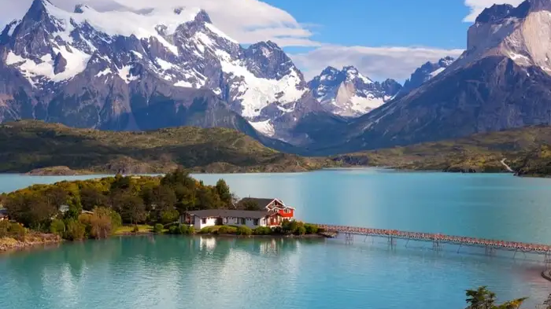
Chile

Slide 9
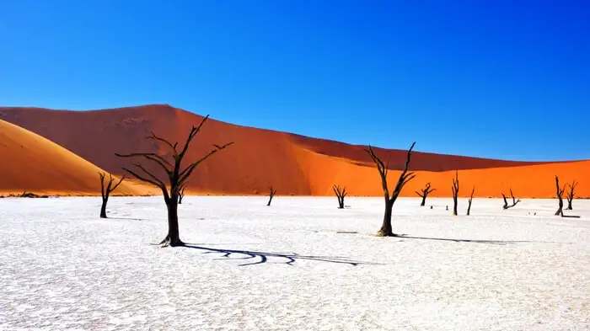
Namibia

Slide 10

TÜrkiye

Slide 12
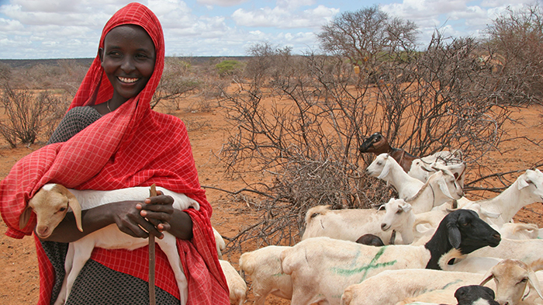
Somali

Slide 13
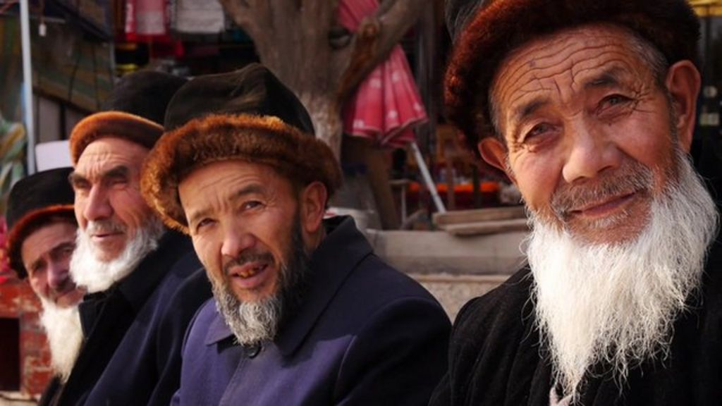
Uyghur

Slide 14
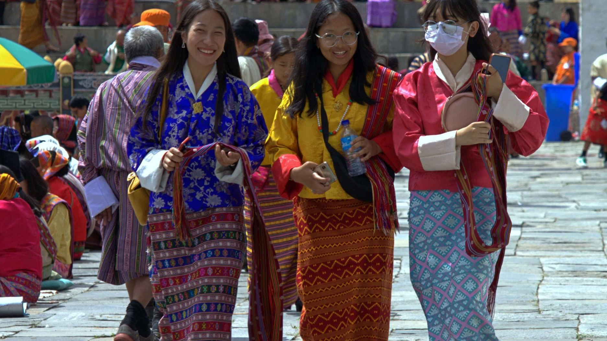
Bhutanese

Slide 15
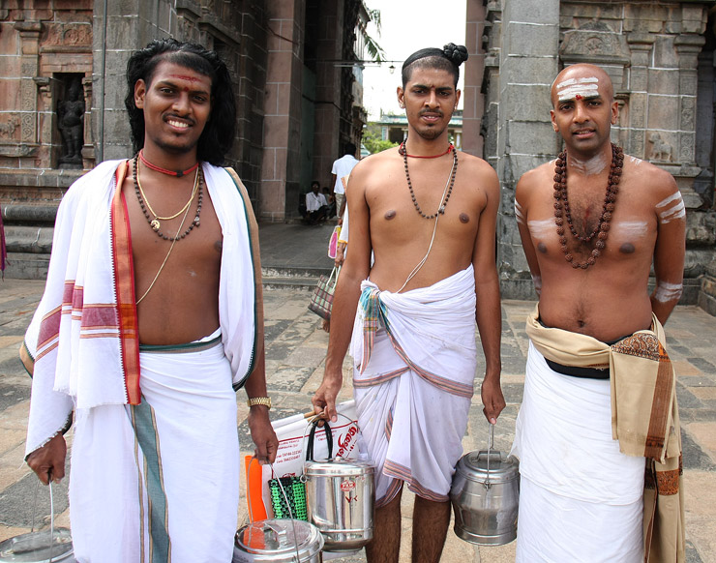
Brahmin

Slide 16
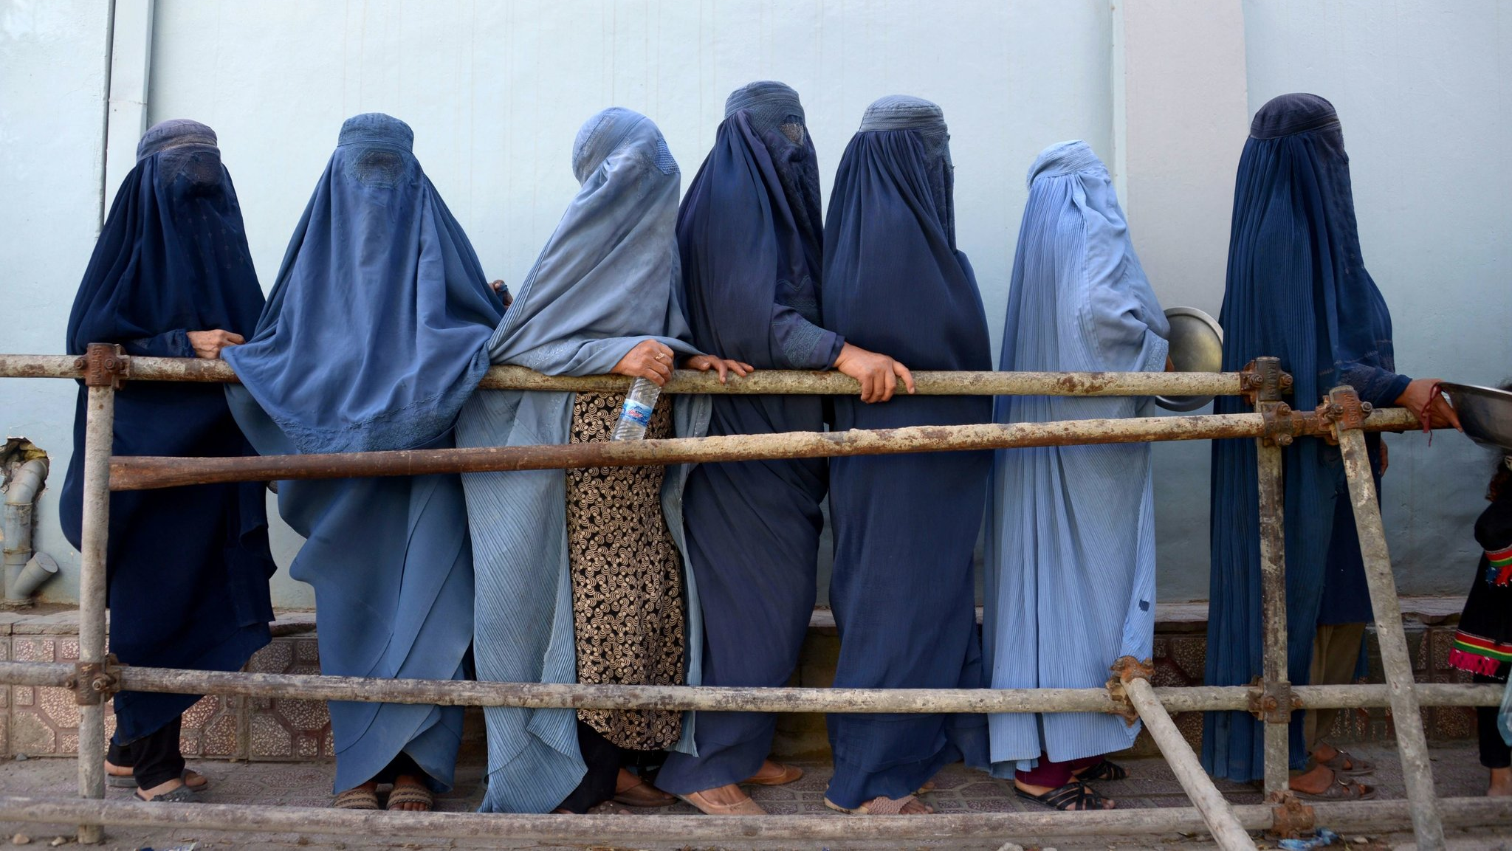
Afghani

Slide 17
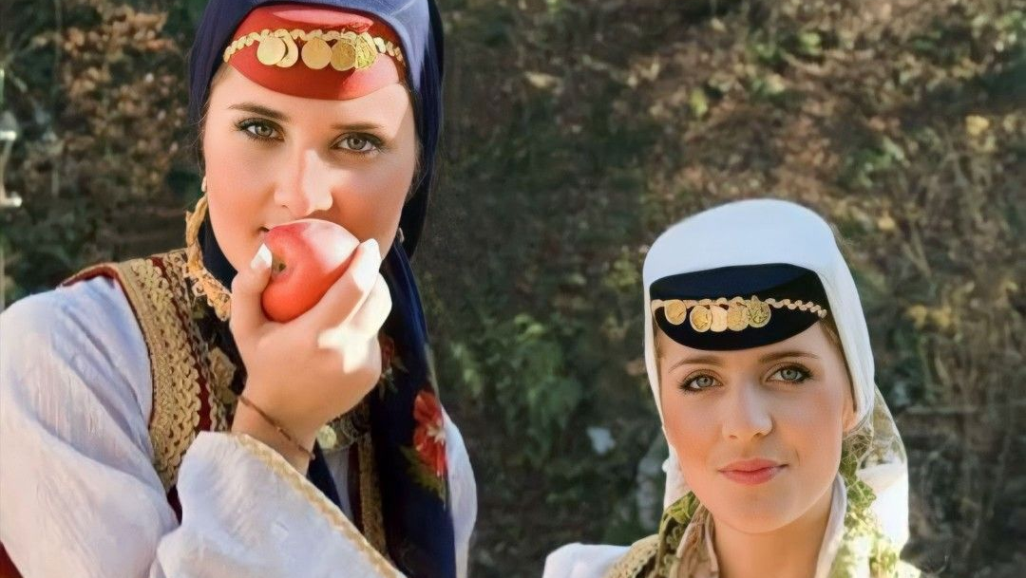
Bosnian

Slide 19
God’s heart for the whole world
Genesis 12:2-3 – God’s promise to Abraham
“I will give you many descendants,
and they will become a great nation.
I will bless you and make your name famous,
so that you will be a blessing....
And through you I will bless ALL THE NATIONS.”

Slide 20
God’s heart for the whole world
Matthew 28:19-20 – Jesus’ command to His followers
“Go, then, to ALL PEOPLES EVERYWHERE
and make them my disciples:
baptise them in the name of
the Father, the Son, and the Holy Spirit,
and teach them to obey
everything I have commanded you.”

Slide 21
God’s heart for the whole world
Revelation 7:9 – John’s vision of heaven
“After this I looked, and there was an enormous crowd — no one could count all the people! They were from
EVERY RACE, TRIBE, NATION, AND LANGUAGE,
and they stood in front of the throne and of the Lamb, dressed in white robes and
holding palm branches in their hands.”

Slide 23
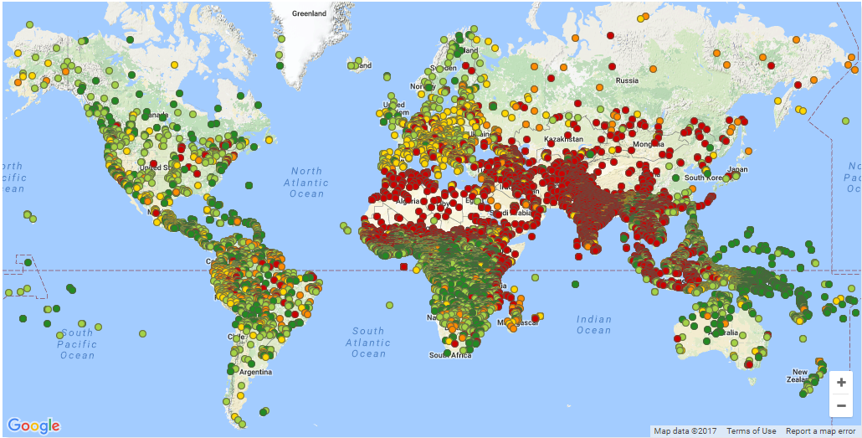



God is on the move!
17,000 People Groups

Slide 24
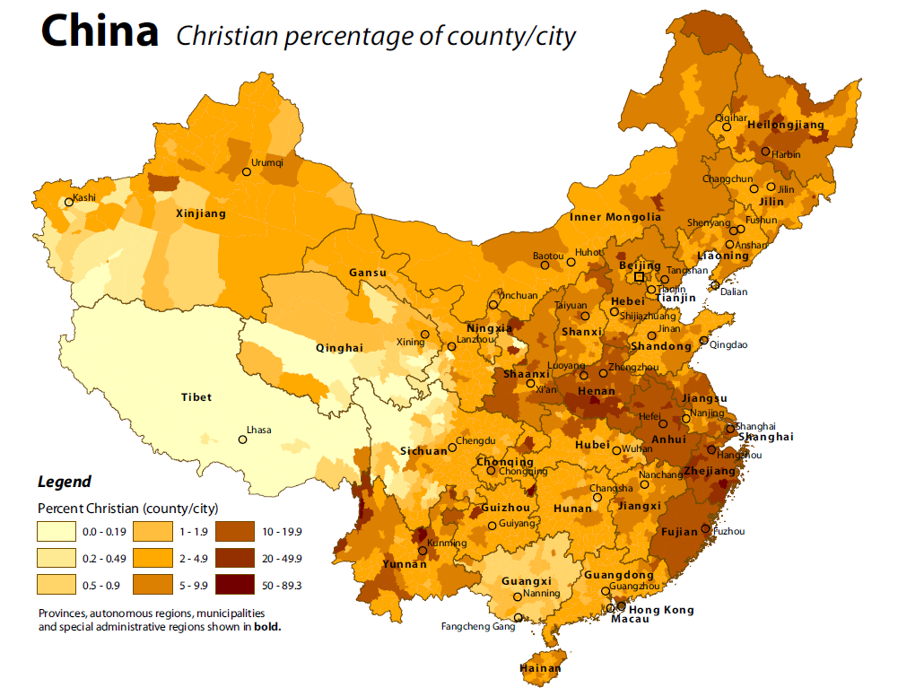

Slide 25


God is on the move!
17,000 People Groups

Slide 26

God is on the move!
17,000 People Groups

Slide 27

God is on the move!
17,000 People Groups

Slide 29
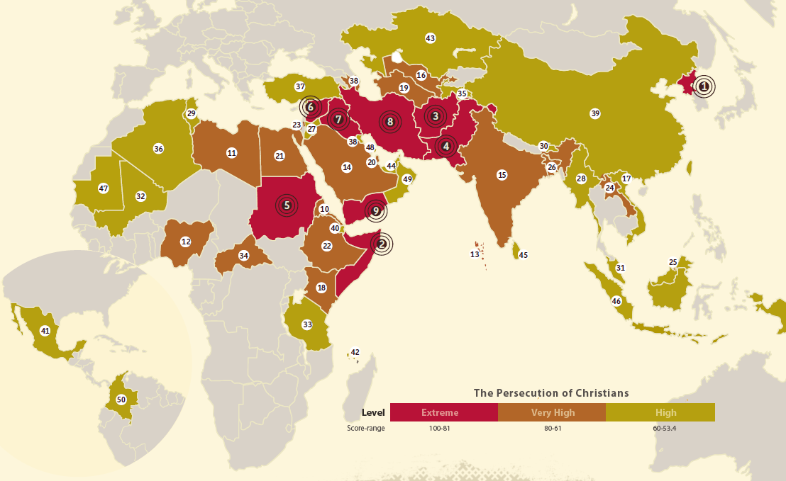

Slide 31
Where are people around parts of the World?

Slide 32

India
4,630 People Groups

Slide 33
Pray
India
4,630 People Groups

